Slide 1




Quiz App
Team no - 6
Batch - 2022 2YB
Allwyn A K, Vidya Kore, Mohammed Arif

Slide 2

Quiz App
Features

Slide 3
Score Tracking
Real-time scoring system
Performance history for users
Detailed score breakdowns
User Authentication
Secure sign-in functionality
Personalized user accounts
Quiz Creation
Customizable quizzes
Ability to add and edit custom questions
Intuitive quiz creation interface
User Interface
Intuitive and visually appealing design
User-friendly navigation
Technical Stack
Built with Flutter for the front end
Firebase used for the backend
Utilizes additional libraries for enhanced functionality
Database Integration
Firebase backend for real-time data storage
Efficient data retrieval and updates

Slide 4
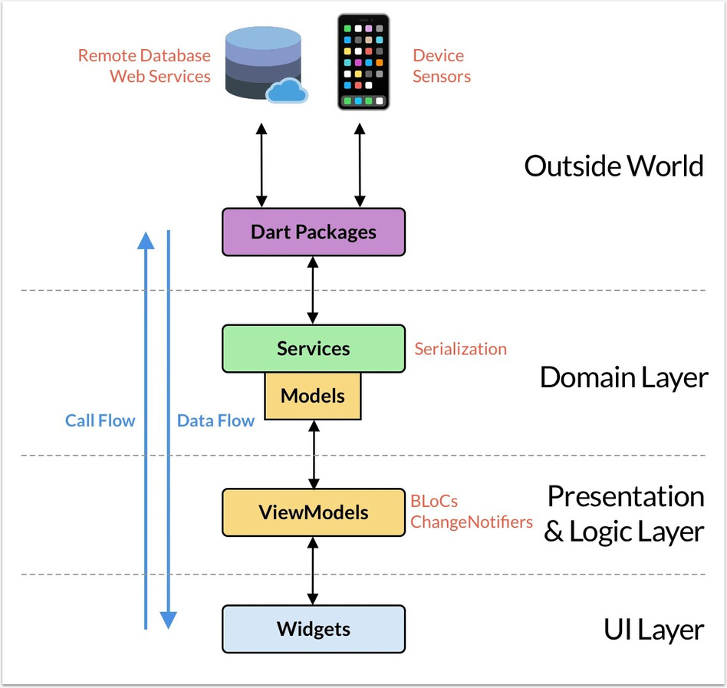
ARCHITECTURE DESIGN

Slide 5

ANDROID

Slide 6
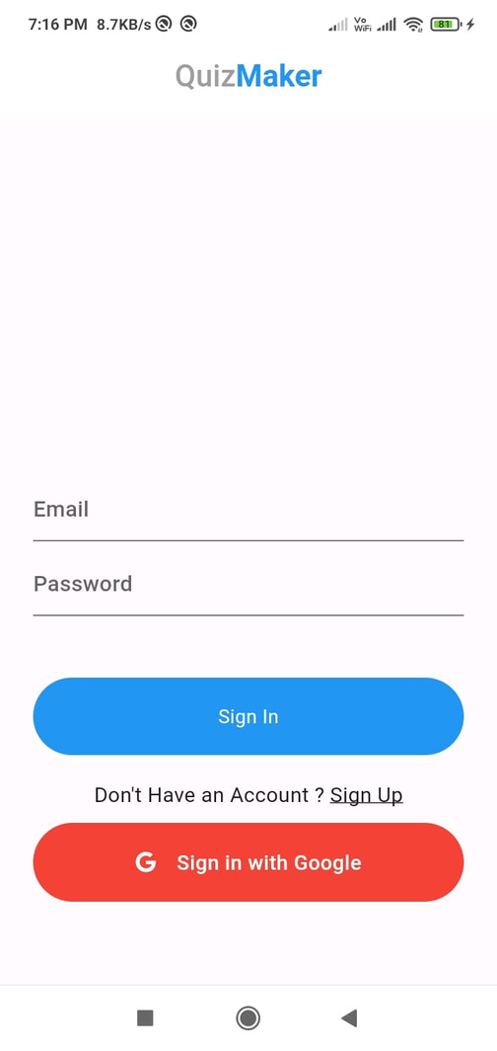
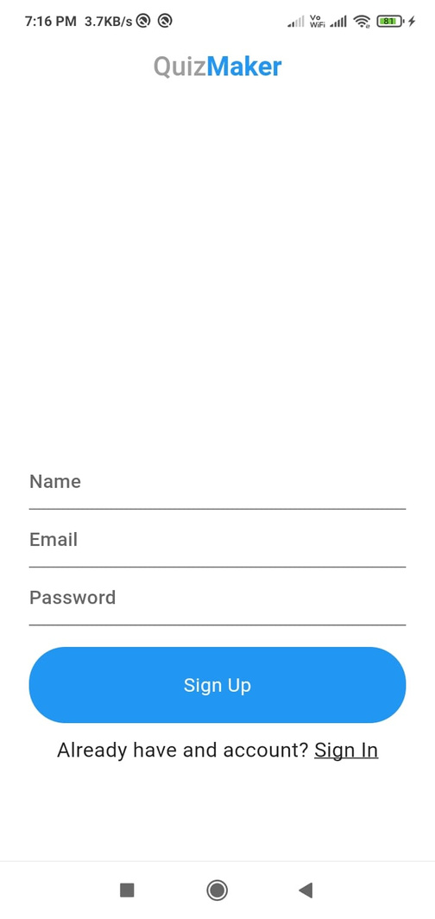
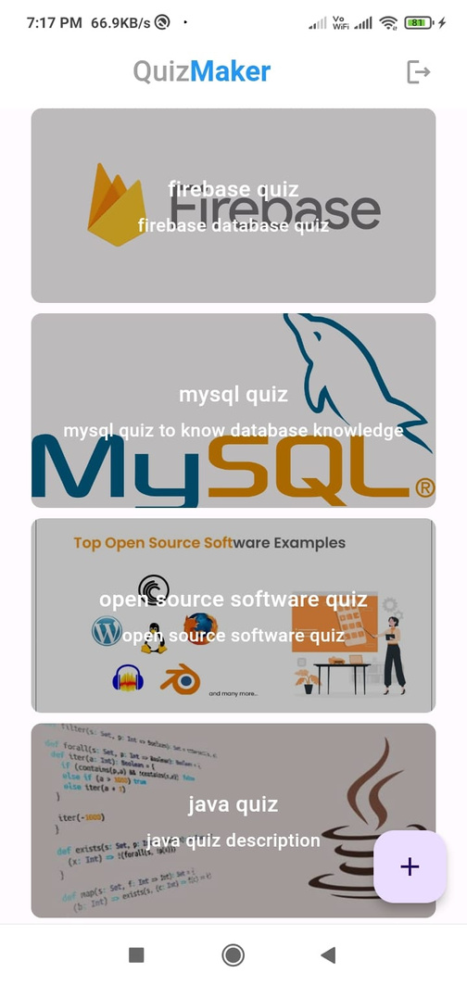
SCREENSHOTS

Slide 7
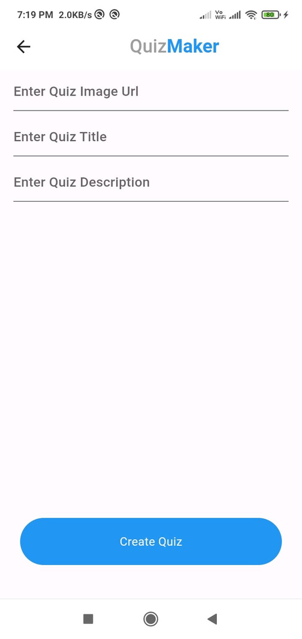
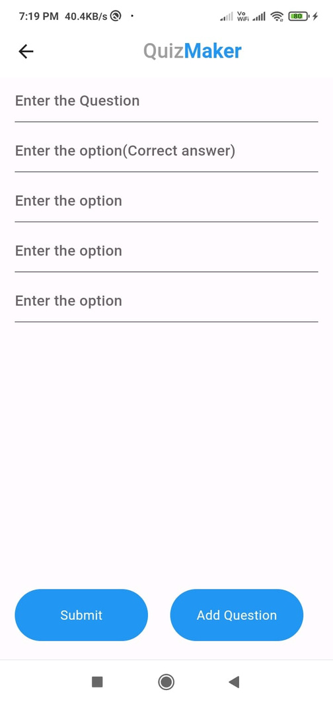
SCREENSHOTS

Slide 8
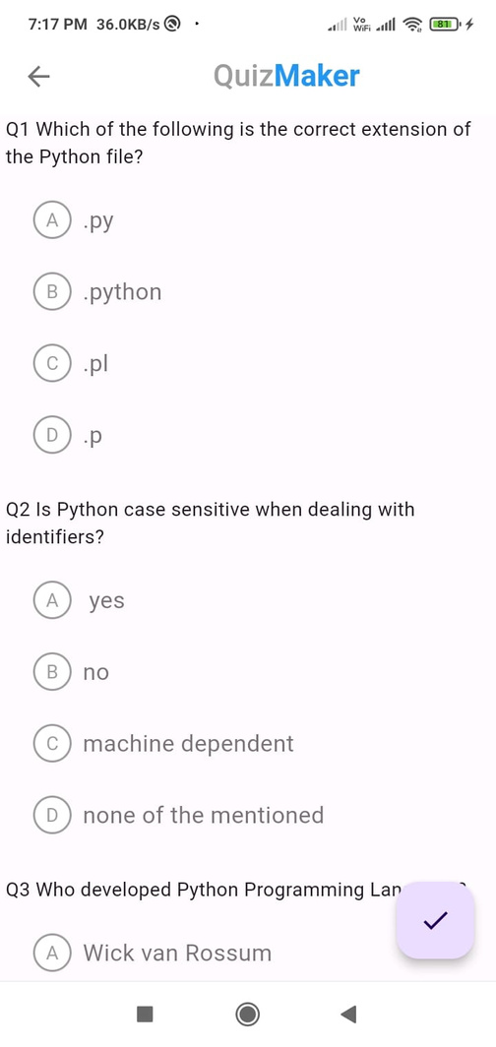
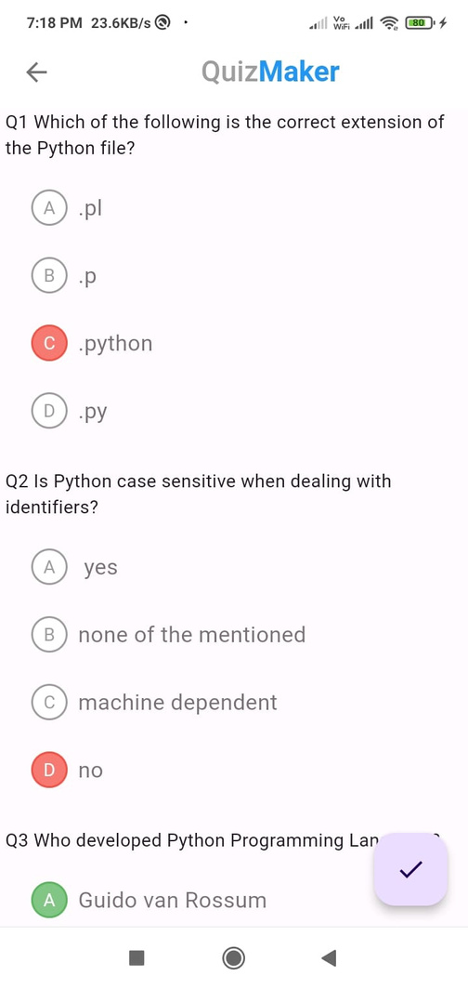
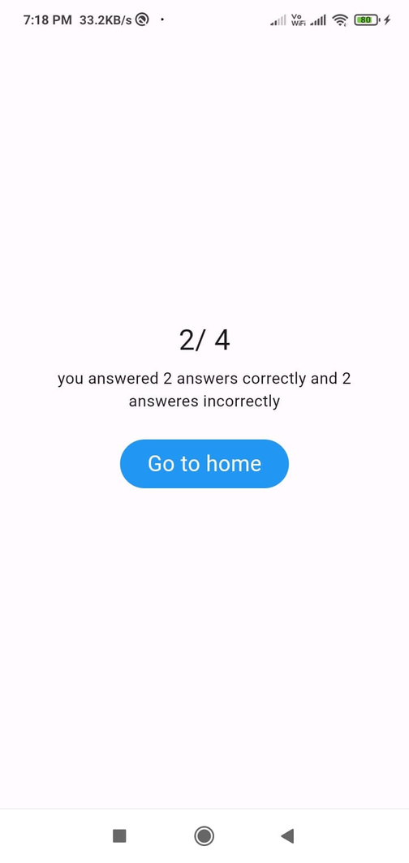
SCREENSHOTS

Slide 9

WINDOWS

Slide 10
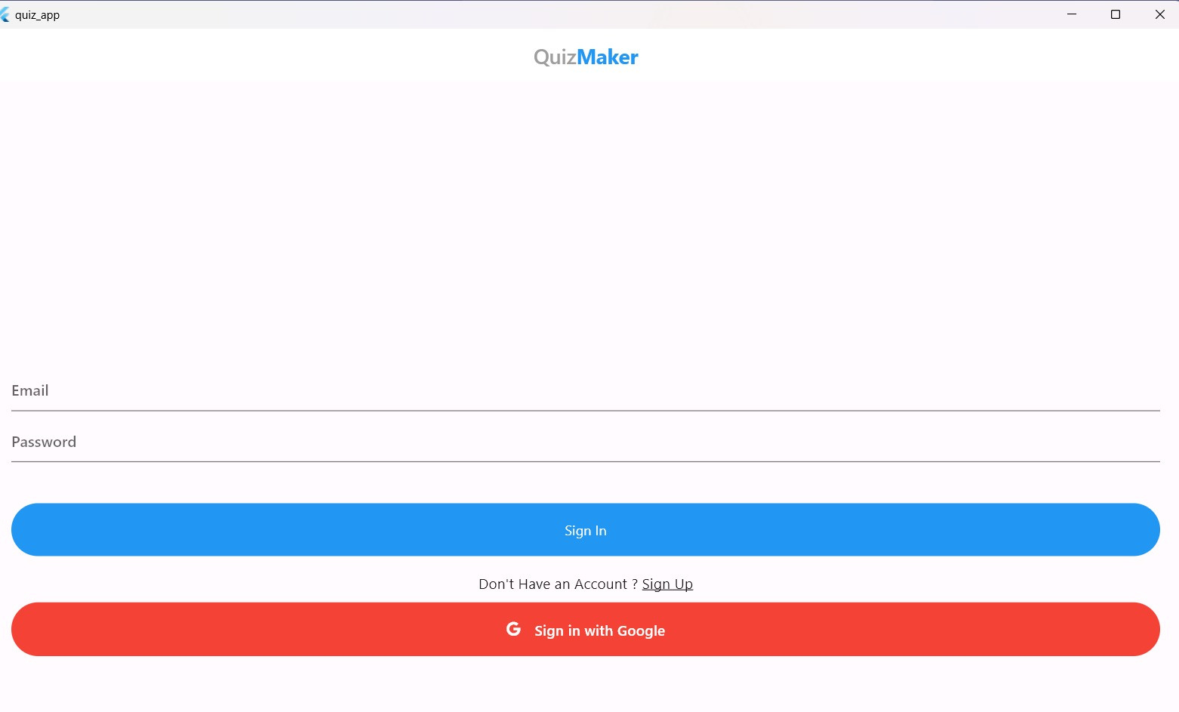
SCREENSHOTS

Slide 11
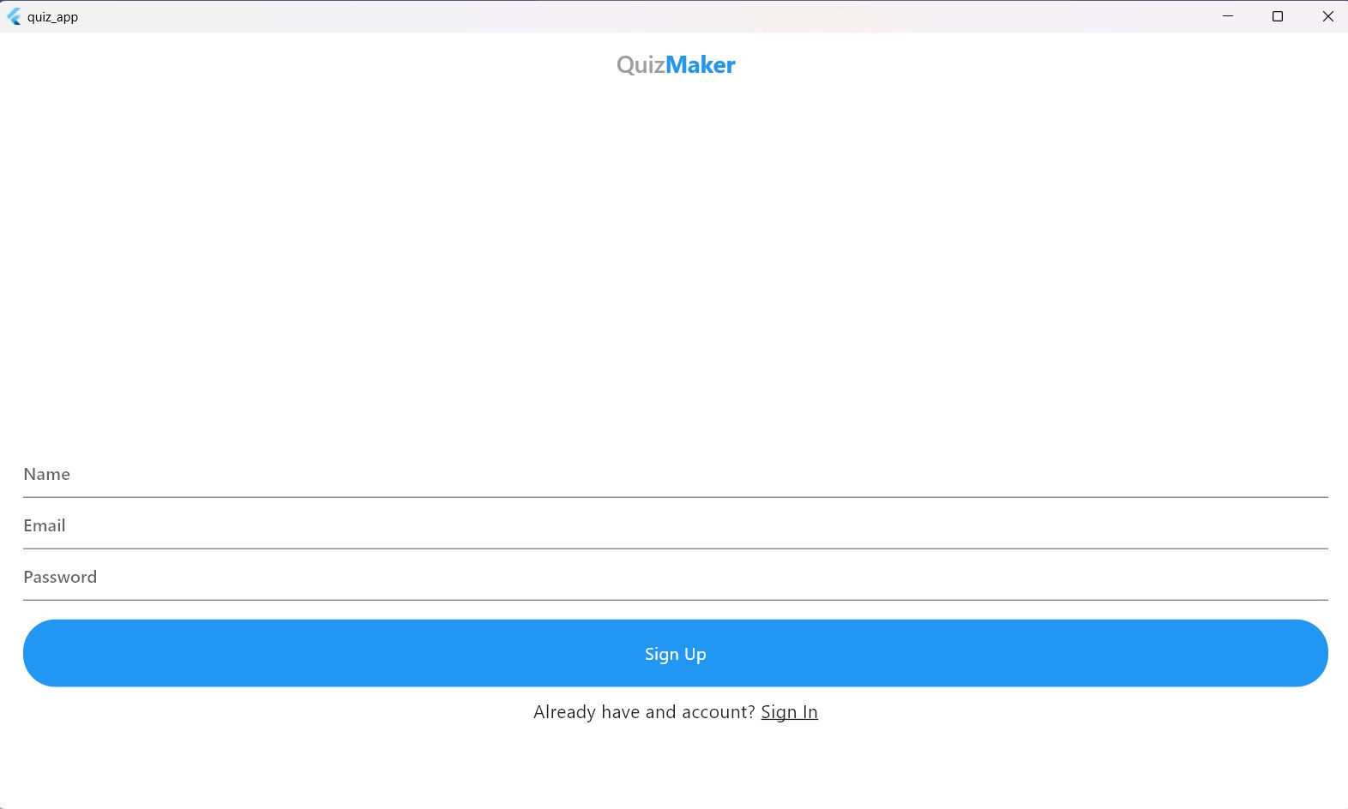
SCREENSHOTS

Slide 12
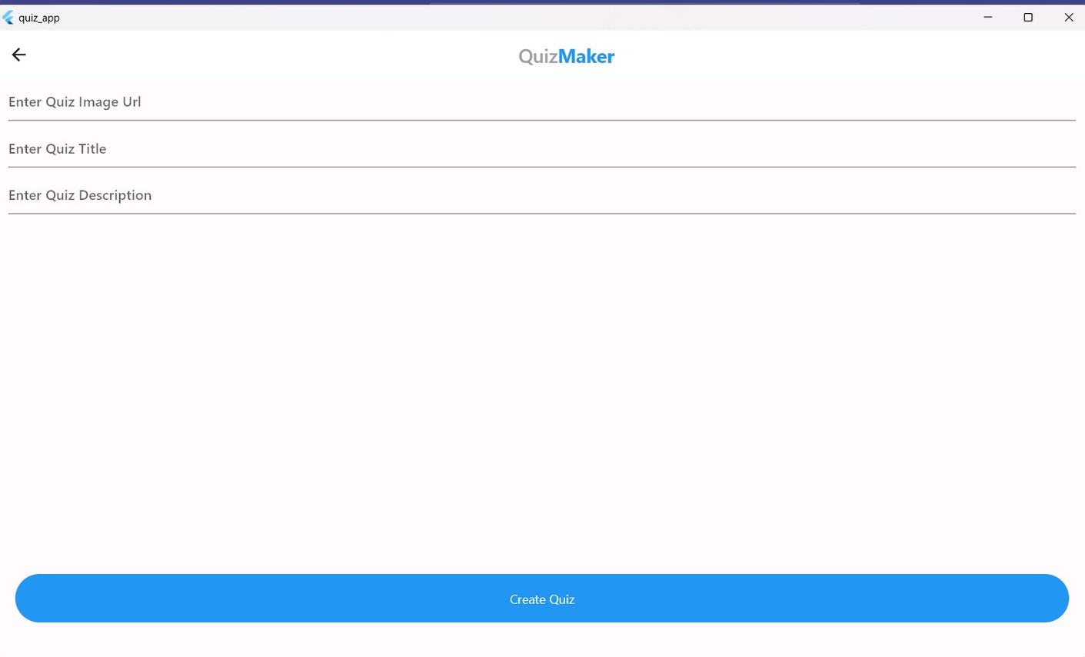
SCREENSHOTS

Slide 13
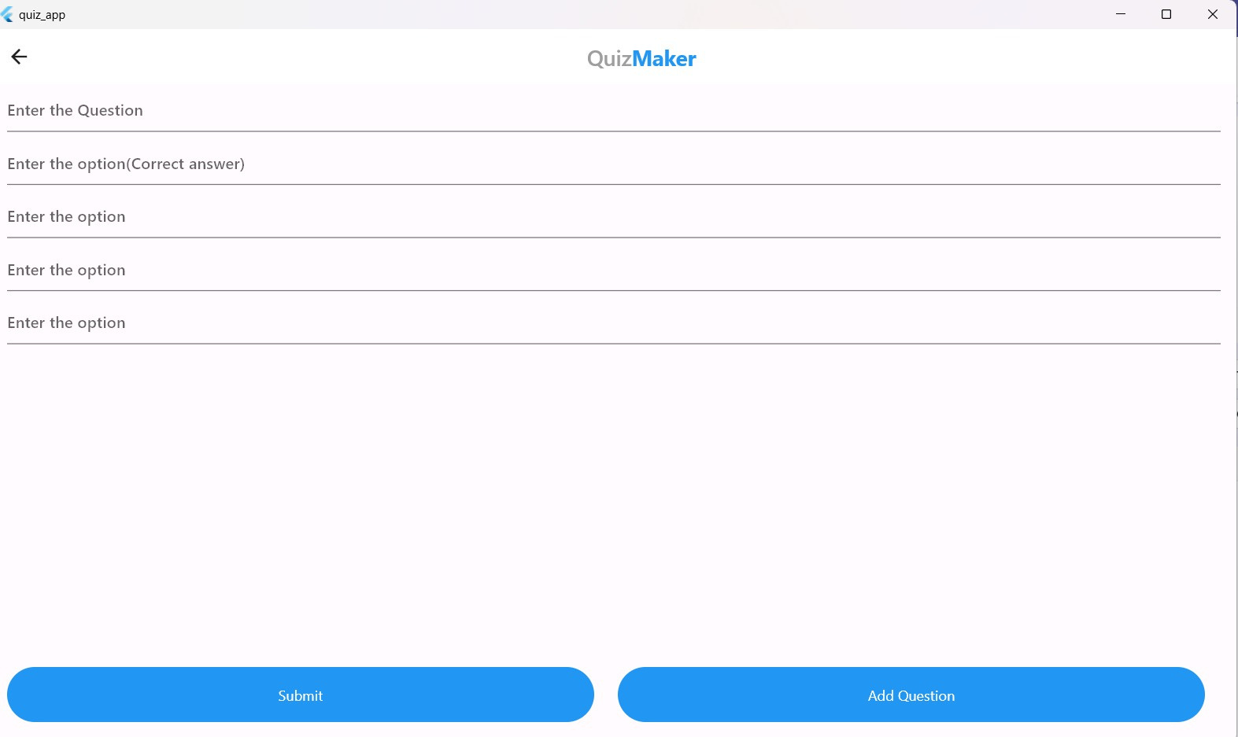
SCREENSHOTS

Slide 14
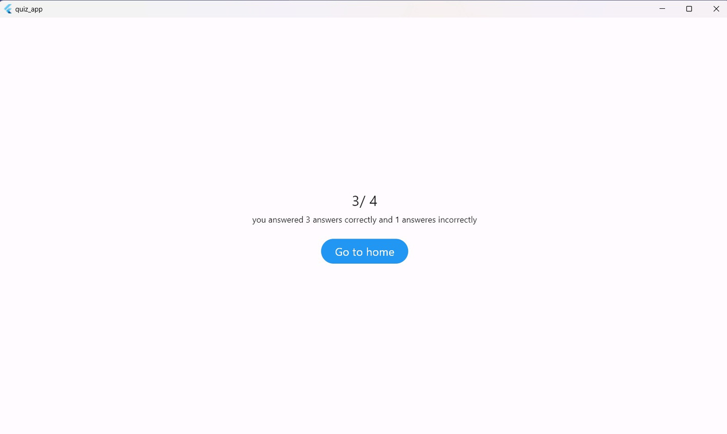
SCREENSHOTS

Slide 15
Challenging points about the project

Slide 16
Real-time Collaboration on Quizzes
Challenge: Implementing simultaneous quiz editing for multiple users.
Interesting Point: Enabling real-time collaboration enhances user experience and engagement.
Scalability
Challenge: Ensuring the app remains performant as the number of users and quizzes grows.
Interesting Point: Designing the app with scalability in mind prepares it for future growth and increased user activity.
Firebase Integration
Challenge: Managing data consistency and security in a dynamic quiz environment.
Interesting Point: Leveraging Firebase for seamless data synchronization and efficient handling of real-time updates.
User Authentication Security
Challenge: Implementing robust security measures to protect user data.
Interesting Point: Ensuring secure authentication enhances user trust and overall app reliability.
Custom Question Types
Challenge: Developing a flexible system for users to create various question types.
Interesting Point: Supporting diverse question formats, including images and multimedia, adds depth to the quiz-taking experience.
Cross-Platform Compatibility
Challenge: Ensuring a consistent user experience across different devices and platforms.
Interesting Point: Offering a seamless experience on both Android and Windows platforms widens your app's reach.

Slide 17
Future enhancements

Slide 18
Students can practice quizzes on the platform. Two types:
Free Tier
Premium tier (Questions by experts)
Multimedia questions
Multiple formats of questions can be asked like video, audio etc.
Timer feature to be implemented
Certificate and badges will be provided after successful completion of the quiz.
These can be shown in social media like linkedin.
Ads will be shown by default.
User will need to upgrade to make it monitizable.
In this way the quiz app can generate revenue.
Detailed analytics of the questions and the users can be made.
For example, if some questions are not answerable by a large amount of users, then that question can be eliminated or we can get details of user’s knowledge by the type of questions he/she answers correctly etc.
Detailed analytics can be done in two ways:
Firebase provides tools to implement this.
We can create custom classification algorithm to implement this.
Also anomaly detection algorithms can detect if the user if cheating while answering the quiz.

